Slide 1
Elementary SWIP 2022-2023

Slide 2
Manson Builds
B = Balanced
We strive to provide a balanced educational experience that incorporates the whole child.
U = United
We, staff, parents, district and community, all work together for the well-being and safety of our students
I = Integrated
We provide integrated, hands-on learning to let kids access knowledge in meaningful ways
L = Learning
We focus on literacy and math as crucial areas to prepare our kids for the future, providing individualized interventions and challenges as needed
D = Diversity
We embrace diversity, respect cultures and languages and teach tolerance.
S = Staff & Students
We have talented and caring educators who work to create meaningful relationships that foster learning for our students.

Slide 3
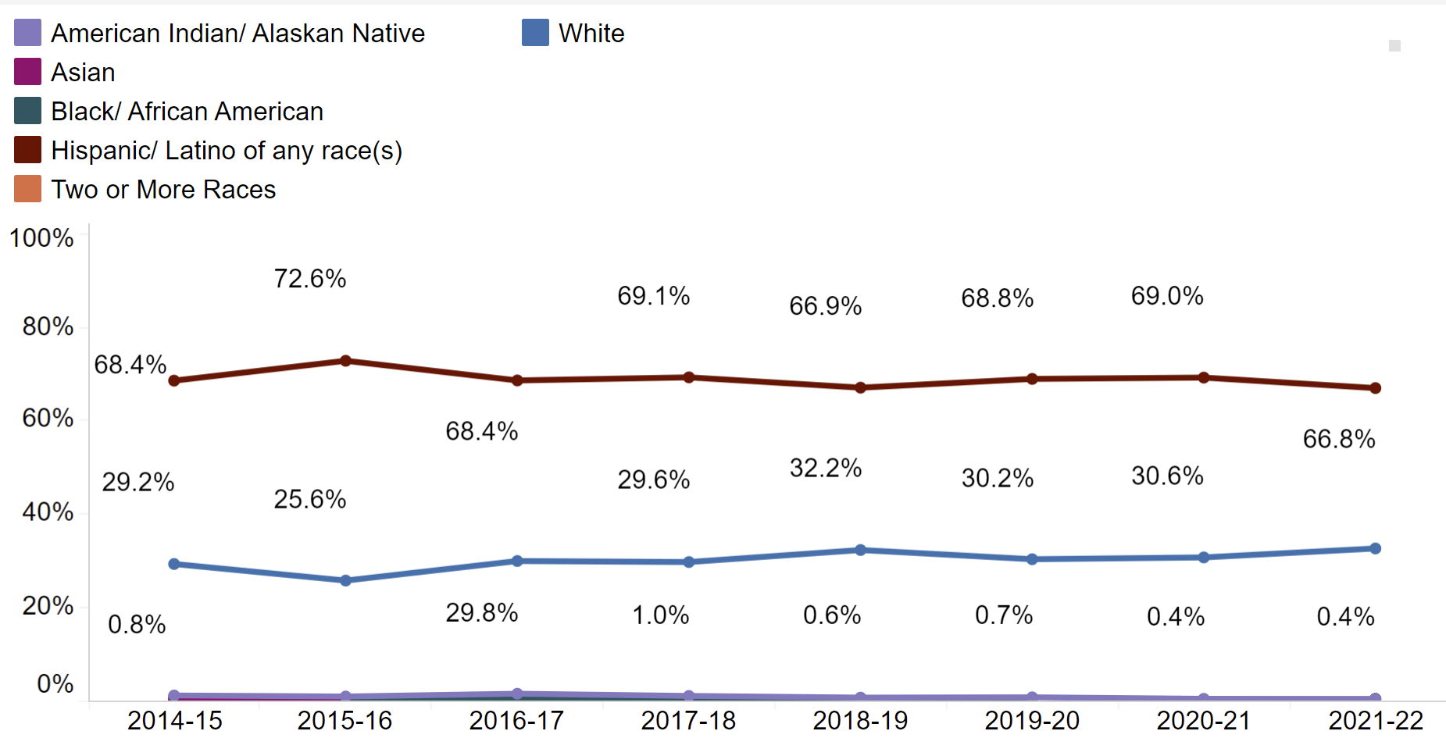
Manson Elementary Enrollment

Slide 4
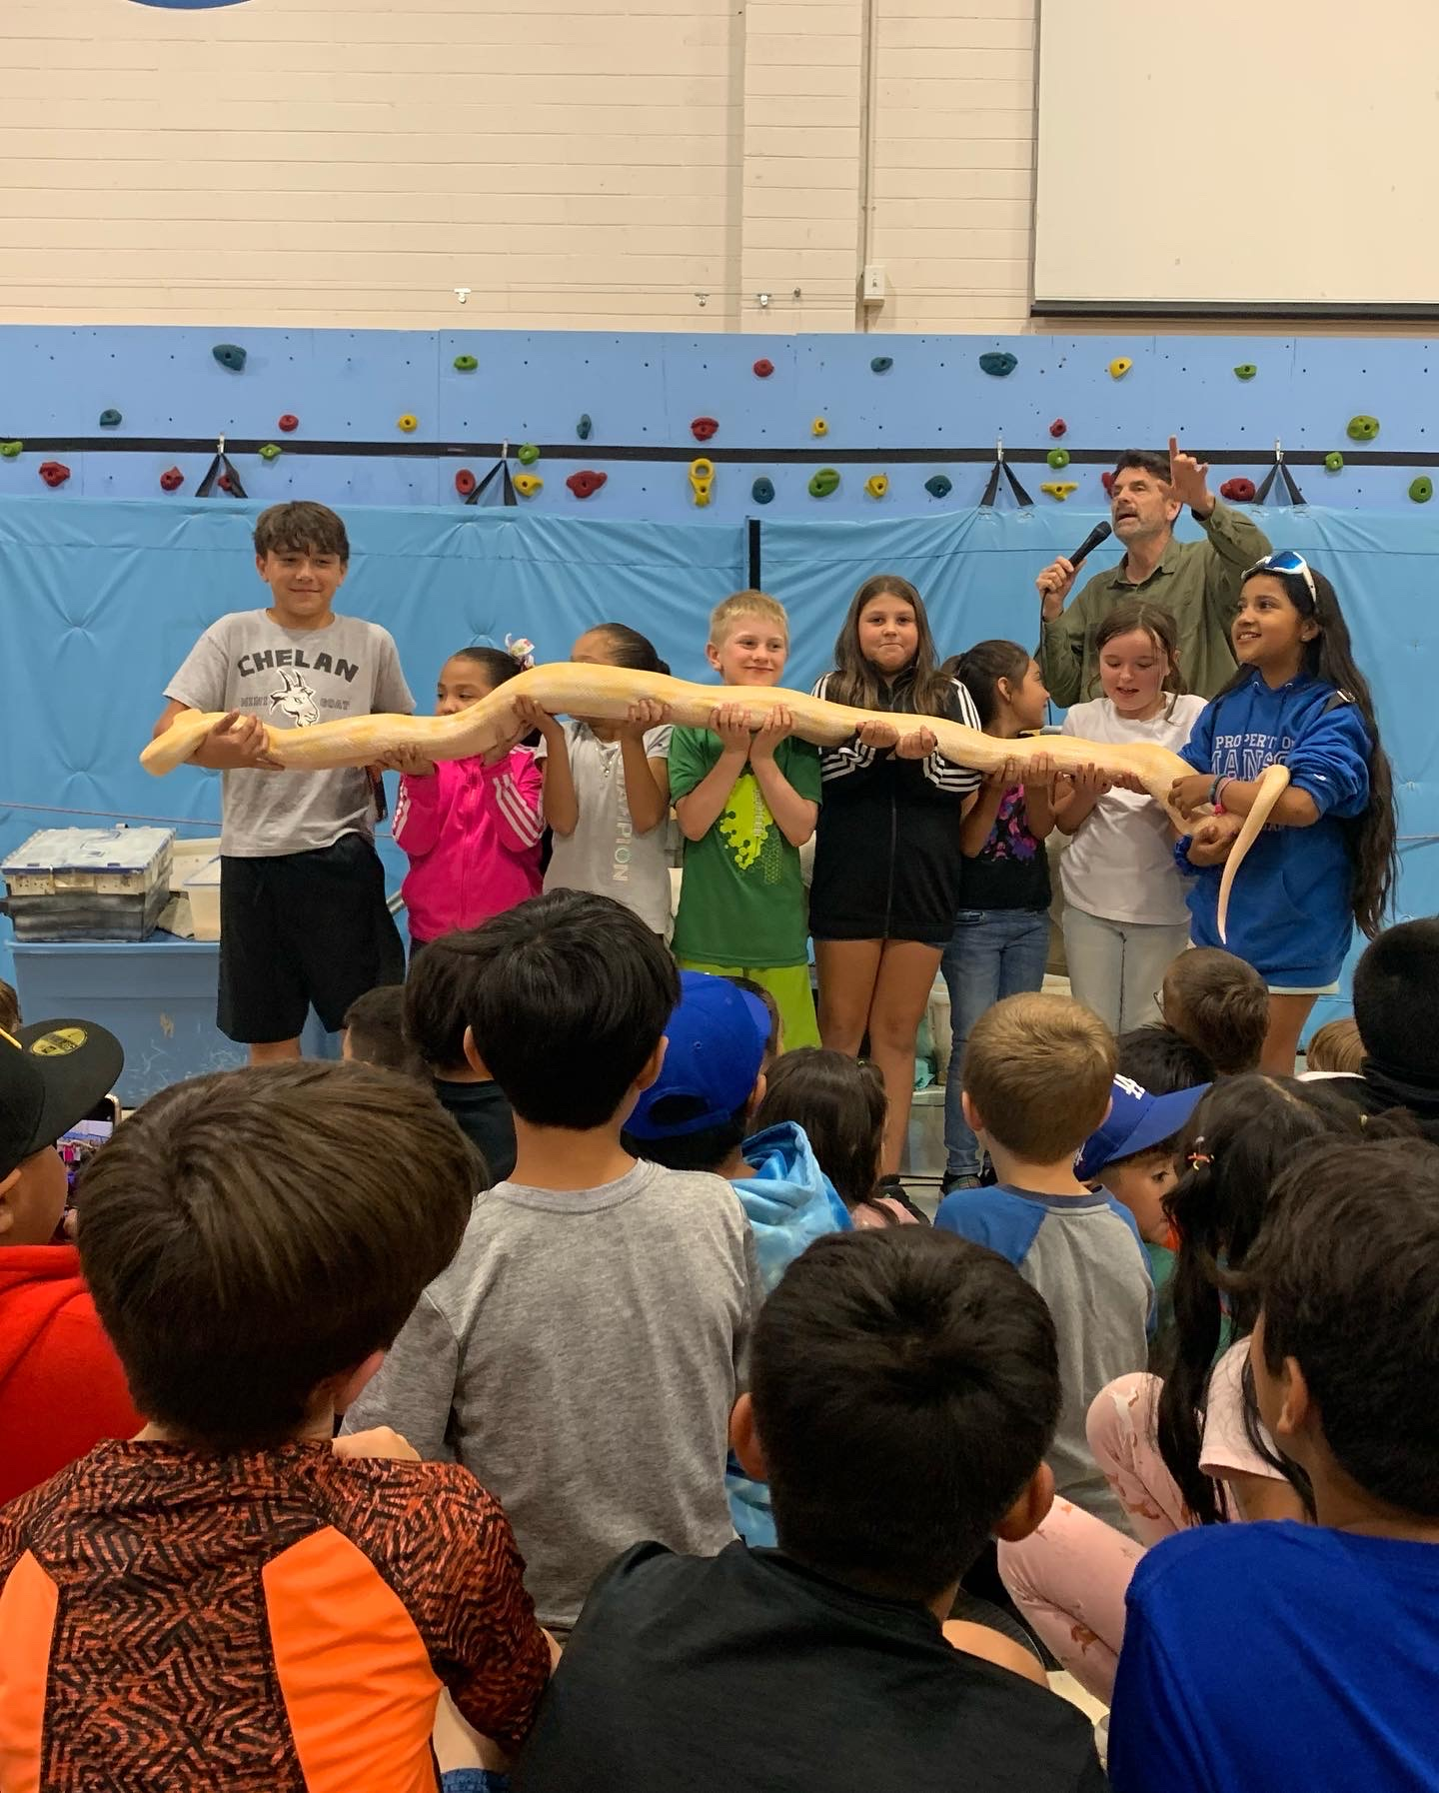
Last year’s highlights
Summative assessment results
Adoption of new ela curriculum
Successful implementation of enrichment program
Adding a full time eld teacher for the 22-23 school year
Spring survey results

Slide 5
Manson Elementary SBA ELA Trend Data
Percent of 3rd - 5th grade students who scored high enough to meet standard

Slide 6
Manson Elementary SBA MATH Trend Data
Percent of 3rd - 5th grade students who scored high enough to meet standard

Slide 7
Spring 22 Proficiency BY GRADE LEVEL

Slide 8
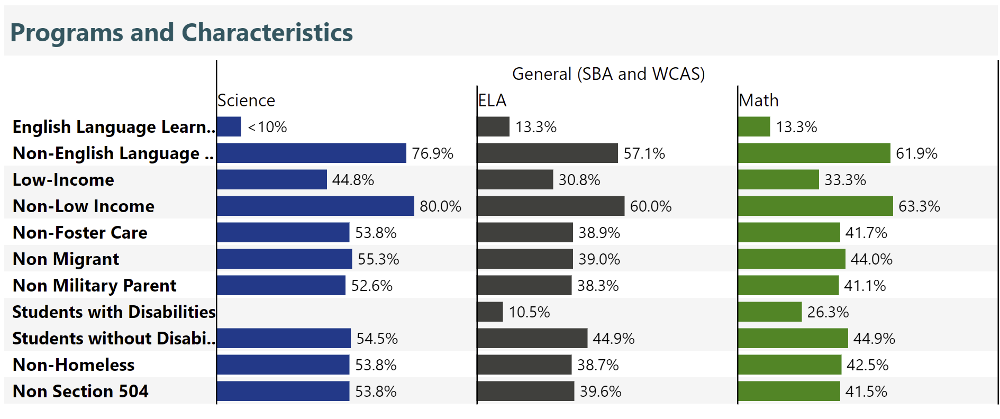
Spring 22 Proficiency BY program

Slide 9
2021-2022 Goal Area: Closing the Gap
ELA Math
2016 21.9 14
2017 17.4 26.1
2018 20.4 31.5
2019 12.5 22.9
2020 19.6 14.3
2021 30.8 33.3
WIDA 2021-2022
Grade | Tested | Exited
Kinder | 22 | 1
1st | 24 | 0
2nd | 27 | 0
3rd | 14 | 0
4th | 18 | 3
5th | 13 | 4
*30% GAP low-income vs non-low-income

Slide 10
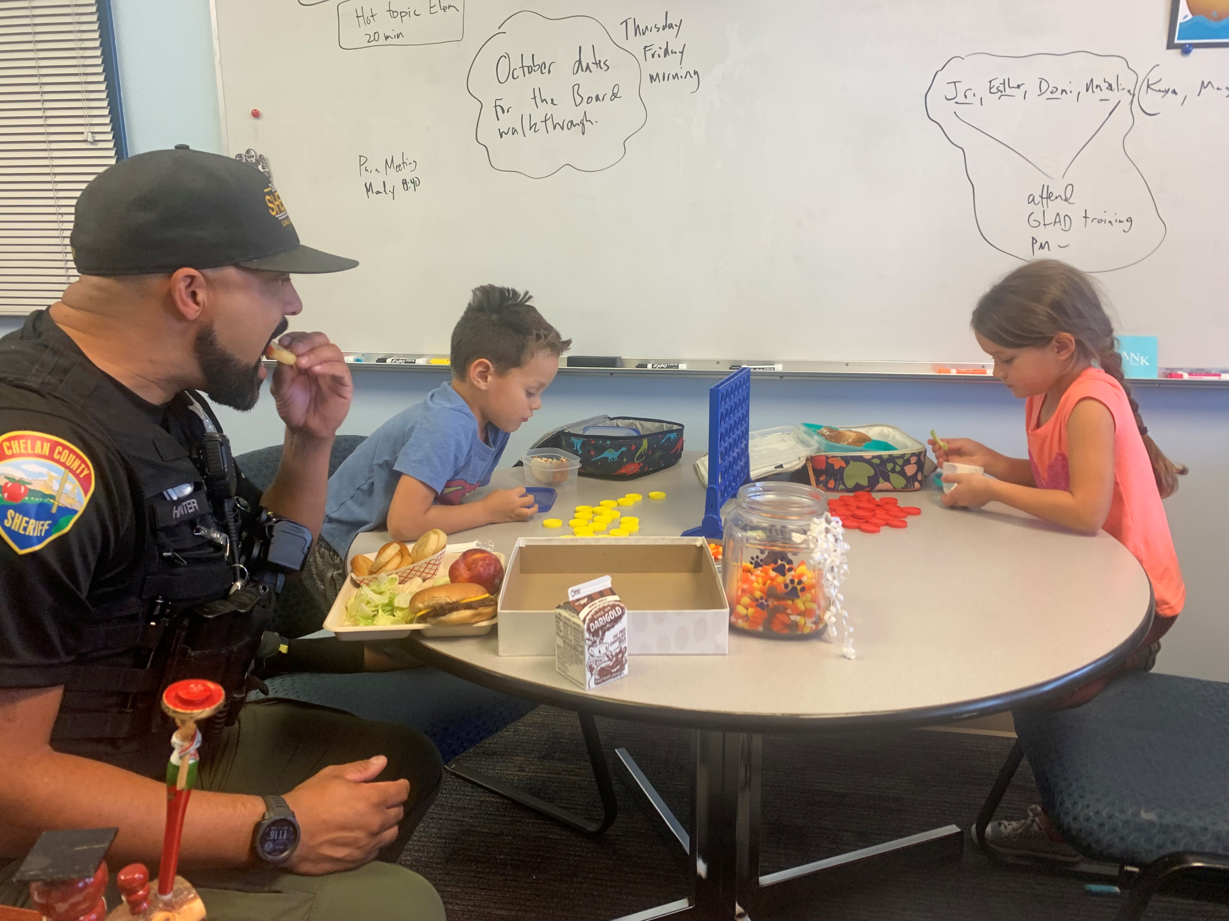
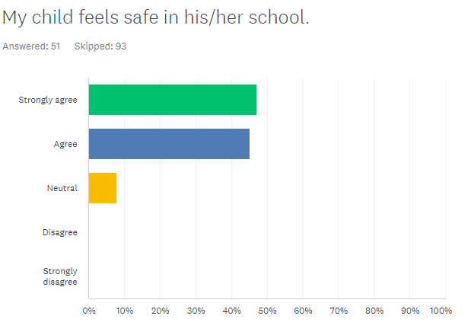
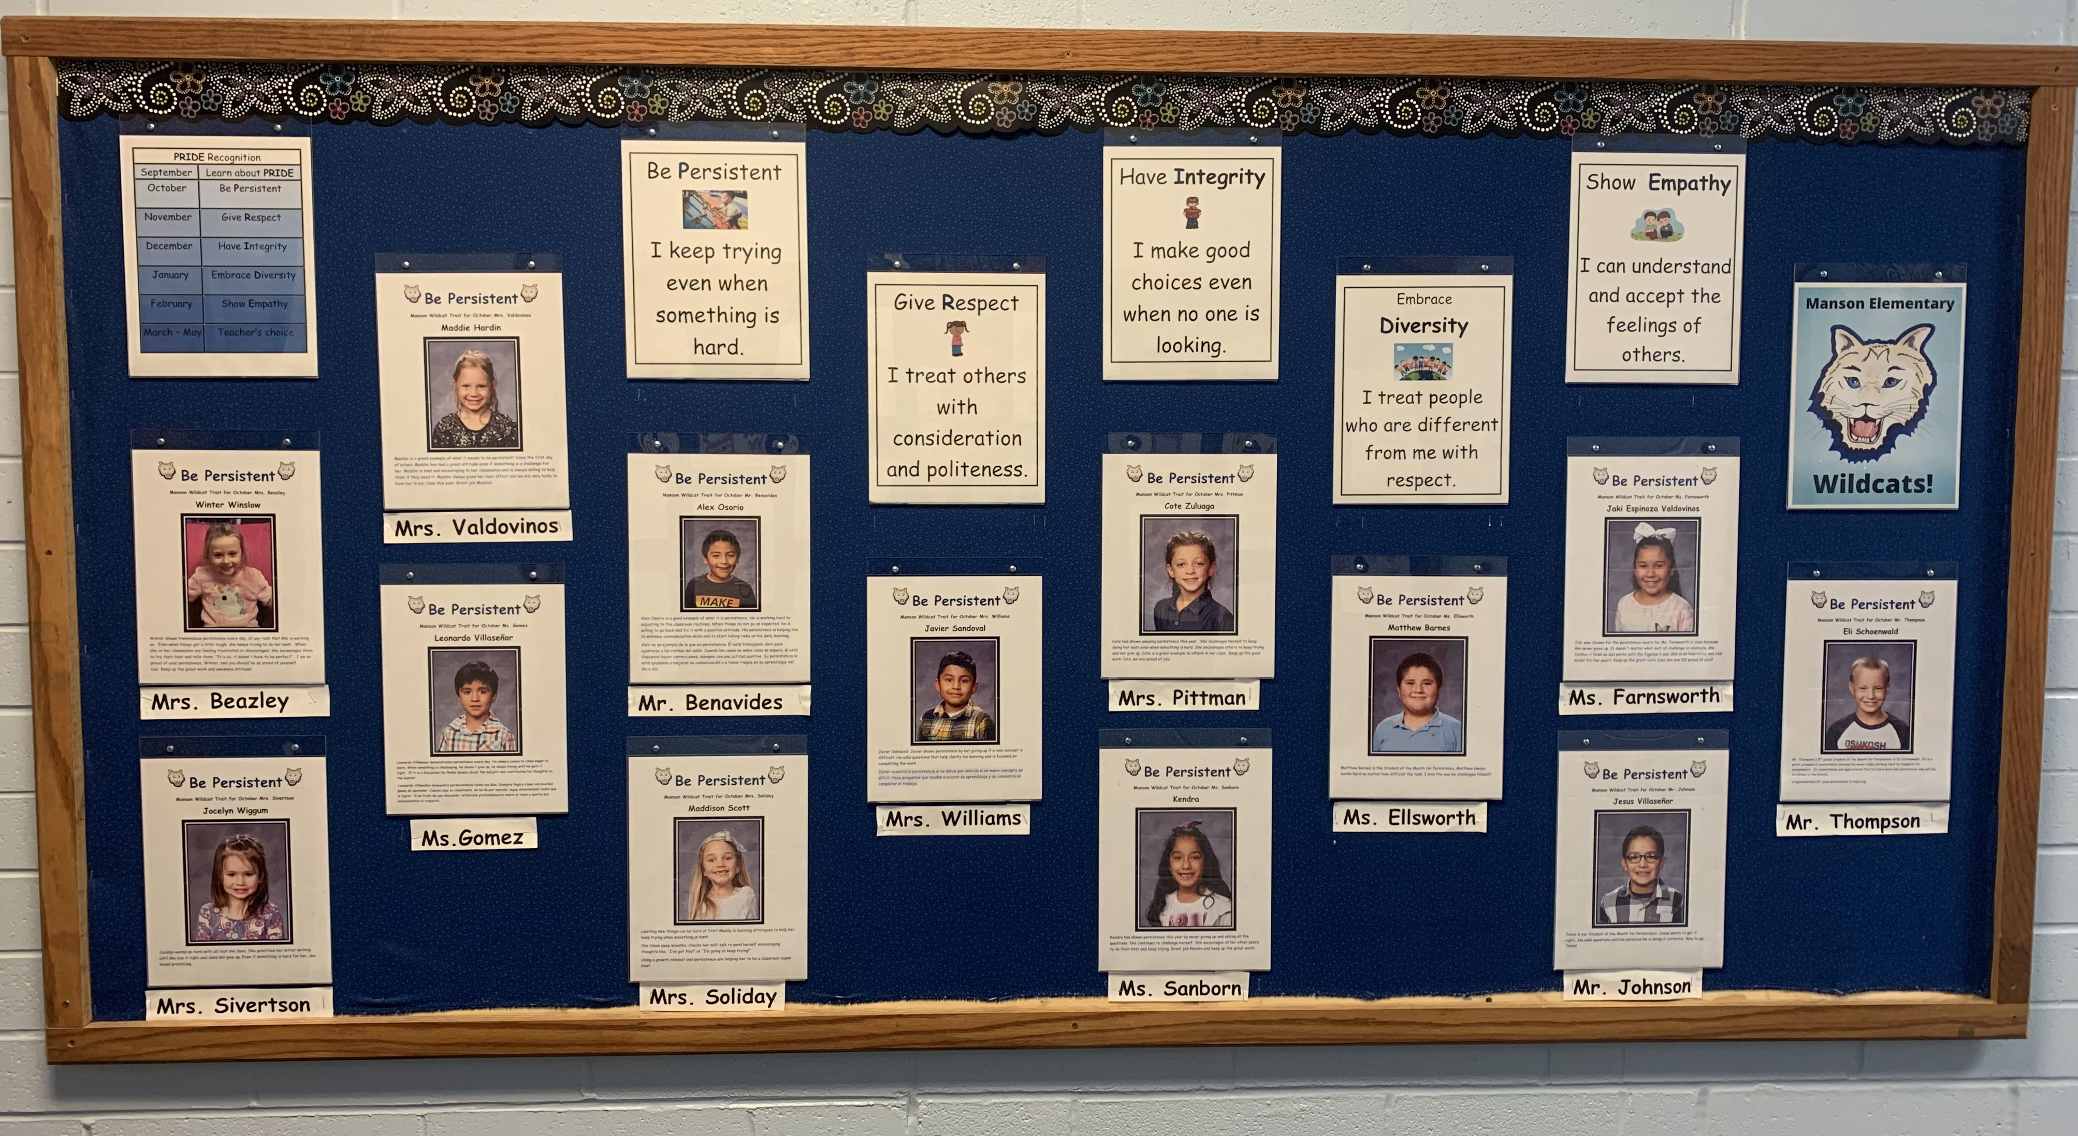
2021-2022 Goal Area: Student Safety/Discipline

Slide 11
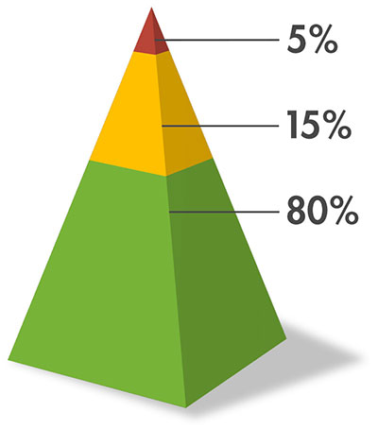
2021-2022 Goal Area: Professional Development - MTSS
Manson Elementary staff will receive professional development on MTSS implementation. The SSIT will expand its work by creating a multi-tiered system that supports student behavior. Our staff will begin the journey towards implementing a school wide multi-tiered system of support that will take into account the whole child. Systems of support will include academic, behavior, and social emotional tiered supports.

Slide 12
2022-2023 GOALS
The 3rd - 5th grade students at Manson Elementary will score above the Washington state average in meeting proficiency for their grade level on the Smarter Balance Assessment in Math and ELA as measured by the Spring 2023 SBA assessment.
The achievement gap between low income and non-low income students will decrease by 10% as measured as measured by the summative Spring SBA Math assessment.
100% of our Multi-lingual learners that are assessed on the WIDA Access, will improve their score in the Speaking domain by at least one level as measured by the WIDA Access assessment taken in the Spring of 2023.

